Slide 1
JDBC

Slide 2
Introduction
Database is an organized collection of data.
A DBMS provides mechanisms for
storing
organizing
retrieving
modifying

Slide 3
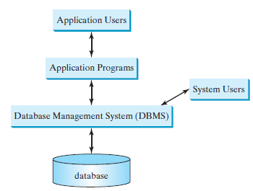
A database system

Slide 4
Popular RDbms
Microsoft SQL Server
Oracle
Sybase
IBM DB2
Informix
PostgreSQL
MySQL
jdk comes with pure-Java RDBMS (Java DB)

Slide 5
Relational database system
Most of today’s database systems are relational database systems
They are based on the relational data model, which has three key components: structure, integrity, and language.
Structure defines the representation of the data.
Integrity imposes constraints on the data.
Language provides the means for accessing and manipulating data.

Slide 6
Introduction
The Java API for developing Java database applications is called JDBC
JDBC provides Java programmers with a uniform interface for accessing and manipulating a wide range of relational databases.
Using the JDBC API, applications written in the Java programming language can execute SQL statements, retrieve results, present data in a user-friendly interface, and propagate changes back to the database

Slide 7
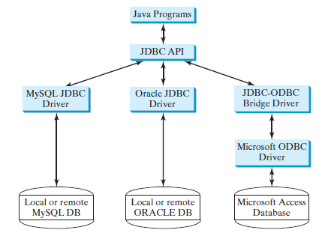

Slide 8
Developing Database Applications Using JDBC
The JDBC API is a Java application program interface to generic SQL databases
that enables Java developers to develop DBMS-independent Java applications using a uniform interface.
The JDBC API consists of classes and interfaces for
establishing connections with databases,
sending SQL statements to databases,
processing the results of the SQL statements,
and obtaining database metadata.

Slide 9
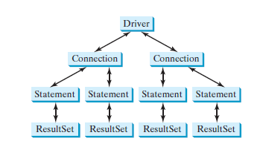
Developing Database Applications Using JDBC
4 key interfaces are needed to develop any database using Java
Driver, Connection, Statement, and ResultSet

Slide 10
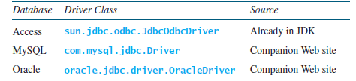
Typical algorithm
Loading drivers
Class.forName("JDBCDriverClass");

Slide 11
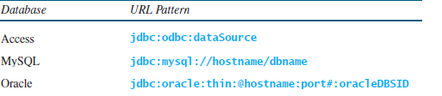
Typical algorithm
Establishing connections
To connect to a database, use the static method getConnection(databaseURL) in the DriverManager class, as follows
Connection connection = DriverManager.getConnection(databaseURL);

Slide 12
Typical algorithm
Creating statements.
Once a Connection object is created, you can create statements for executing SQL statements as follows:
Statement statement = connection.createStatement();

Slide 13
Typical algorithm
Executing statements
An SQL DDL or update statement can be executed using executeUpdate(String sql), and an SQL query statement can be executed using executeQuery(String sql)
The result of the query is returned in ResultSet.
For example, the following code executes the SQL statement create table Temp (col1 char(5), col2 char(5)):
statement.executeUpdate ("create table Temp (col1 char(5), col2 char(5))");

Slide 14
Typical algorithm
Executing statements
The next code executes the SQL query select firstName, mi, lastName from Student where lastName = 'Smith':
// Select the columns from the Student table
ResultSet resultSet = statement.executeQuery ("select firstName, mi, lastName from Student where lastName “
+ " = 'Smith’ ");

Slide 15
Typical algorithm
Processing ResultSet
The ResultSet maintains a table whose current row can be retrieved. The initial row position is null.
use the next method to move to the next row and the various get methods to retrieve values from a current row.
while (resultSet.next())
System.out.println(resultSet.getString(1) + " " +
resultSet.getString(2) + ". " + resultSet.getString(3));

